Slide 1

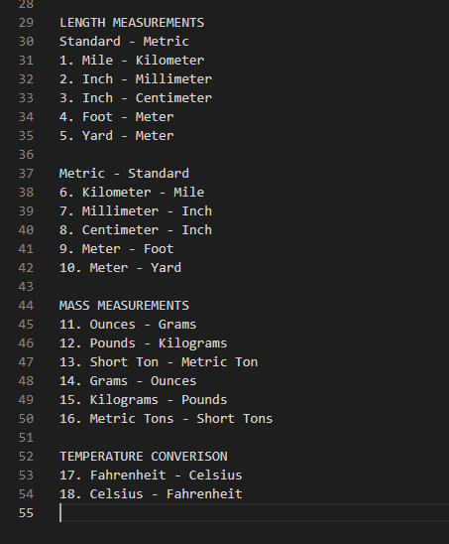
Temperature/Unit Conversion Program
Team Member(s): Andrew Able
This program is designed to be a basic unit and temperature conversion calculator using functions, print statements, loops, and if statements.
You will be given the choice to choose which measurements to convert by typing a number 1-18.
This calculator will continually operate until the user presses Z to break the program

